Slide 1
While we wait to start…
Please follow the directions on the handout available on the tables in the room. *Amazon Music App
I encourage everyone to participate.
If you do not have a device, you can follow along on the screen with me or partner up with someone near you.
The presentation will start shortly…

Slide 2

Changing the Dialogue
Interacting with Text Forms through Voice Input Devices

Slide 3
Overview of Presentation
Who I am and what I am working on
Very Brief and Incomplete History of User Input Methods
What makes up an Alexa Skill
Workshop:
Build a simple HelloWorld Skill
Build a Q&A Skill
Explore Interactive Adventure Game Tool
Build a Skill to Ask and Store User Responses
Application to ongoing projects

Slide 4
Other Information
This workshop should run about an hour and half.
I encourage anyone that has questions to ask.
You are encouraged to follow along during the Skill creation.
If I talk too fast or you would like me to repeat something, please let me know!

Slide 5
Who is this guy?
Michael Powell
Education
Information Technology with a Minor in Digital Media
Master’s in Digital Forensics
Ph.D. student in Texts & Technology
Worked 11 years with the university
Currently helping manage the Computer Science Senior Design capstone courses
I love technology!

Slide 6
Projects
Polycystic Ovarian Syndrome (PCOS) Application
Medical Financial Aid Chatbot
NLP Patient Form Processing
Blockchain Medicine Tracking

Slide 7
PCOS Application
Passed IRB with the University of Central Florida (UCF) and Orlando Health
Was internally tested at UCF’s College of Medicine (CoM)
Now being run and maintained by doctors at UCF’s CoM
They wanted to survey patients.

Slide 8
Medical Financial Aid Chatbot
Development is nearing the end.
Will be open source and free for anyone to implement.
Currently moving from a web chatbot to an Alexa skill

Slide 9
NLP and Blockchain Projects
Both are at the beginning of development
NLP is gathering data to generate a profile for depression.
Blockchain is researching the competing technologies to determine which is most resilient against tampering.

Slide 10
From PCOS to NLP
The NLP project is a continuation of a request from the PCOS project.
Help identify users that are depressed so that someone can try to talk to them about what is going on.
This was outside of the scope for the original PCOS application and became its own project.

Slide 11
Where does Alexa / Chatbot fit in?
Survey people at home like ResearchKit allows for the PCOS application.
It is easier and more comfortable for users.
PRIDE Study
It will use the responses from the user to assist them.

Slide 12
The Very Brief and Incomplete History of User Input Methods

Slide 13
Modern Day User Input
The first typewriter was patented in October of 1867
The QWERTY layout was finished in March of 1873
This led the way for teleprinters in the 1920s, that could transmit typed message through telephone lines
The Flexowriter, developed in the 1950’s, was a device that could read and write to paper tapes
Theses tapes were used with the Computer Research Corporation’s Card-Programmed Calculator (CRC-102A)
Which could do 11 multiplications a second

Slide 14
Modern Day User Input
The modern day mouse was a dissertation topic in 1963 by Ivan Sutherland.
The first actual mouse was produced in 1965 at Stanford.
Before the development of the mouse, light pens were used as an alternative interaction method.

Slide 15
Modern Day User Input
We no longer need a mouse!
Touchscreen are everywhere
Computers, kiosks, smart phones, and more…
The concept of a touchscreen was originally proposed in 1965 by E. A. Johnson
In 1967 he published an article showing how it could be used by air traffic controllers

Slide 16
Why is verbal important now?
Verbal input is one of the earliest forms of user input.
Poets would modify stories based on their audience’s input. (Ong 58)
Learning to respond or give input verbally is one of the earliest thing we teach children.
People who are illiterate can often communicate fine verbally.

Slide 17
Why is verbal important now?
Written text cannot respond to verbal questions, like a narrator can. (Ong 59)
You can’t ask a book a question.
The argument that text is dead/lifeless.
With verbal input and auditory responses, a user can get clarification.

Slide 18
Why is verbal important now?
The goal of any program should be to simplify a process and help the user.
How can we make complex process streamlined and easier?
Medical Financial Aid Chatbot?

Slide 19
What makes up an Alexa Skill?

Slide 20
What makes up an Alexa Skill?
What is a “Skill”?
Voice driven application for Alexa devices
Made up of two parts
Alexa Skills Kit (ASK)
“Frontend” - This tool assists with developing the “skill interface” the user interacts with verbally.
Amazon Web Services (AWS)
“Backend” - Handles the “skill service”, which processes the request and sends a response.

Slide 21
What makes up an Alexa Skill?
Our skill service will be written in Node.js for this workshop
You can run a skill service on your own servers
We will stick with Amazon Lambda for the this workshop

Slide 22
Terminology
Example query to a skill
“Alexa tell HASTAC Conference Hello”

Slide 23
Terminology
Example query to a skill
“Alexa tell HASTAC Conference Hello”
Alexa is the wake word.
It can also be Echo or Amazon.
It is not necessary on devices with manual activation.

Slide 24
Terminology
Example query to a skill
“Alexa tell HASTAC Conference Hello”
Tell is the starting phrase.
Common starting phrases are ask, open, launch, and run.
Here are all the supported phrases:
https://developer.amazon.com/docs/custom-skills/understanding-how-users-invoke-custom-skills.html

Slide 25
Terminology
Example query to a skill
“Alexa tell HASTAC Conference Hello”
HASTAC Conference is the Invocation Name
This is how the user identifies which skill they want to interact with.
You will set this in the Amazon Skills Kit (ASK)

Slide 26
Terminology
Example query to a skill
“Alexa tell HASTAC Conference Hello”
Hello is the utterance
This is what the Skills Interface will process and pass to a function (intent) handled by the Skill Service
These can be much longer, such as “where is cafeteria”

Slide 27
Terminology
Skill Service
Handlers – Make up most of the content in the skill service
They handle the users input.
The default handler is “LaunchRequest” which activates when user starts the skill.
Intent - Responsible for resolving a specific function a user is trying to do.

Slide 28
Questions before moving on?

Slide 29
Let’s stop talking and start programming…
HelloWorld Skill
Please download Example1.Step.js
http://www.michaelrpowell.com/hastac2017/

Slide 30
Terminology
Skill Service
Slots – These are used when different words could be at a certain location in an utterance
“Where is the bathroom”
“Where is the arena”

Slide 31
Questions before moving on?

Slide 32
Back to Programming…
Q&A Skill

Slide 33
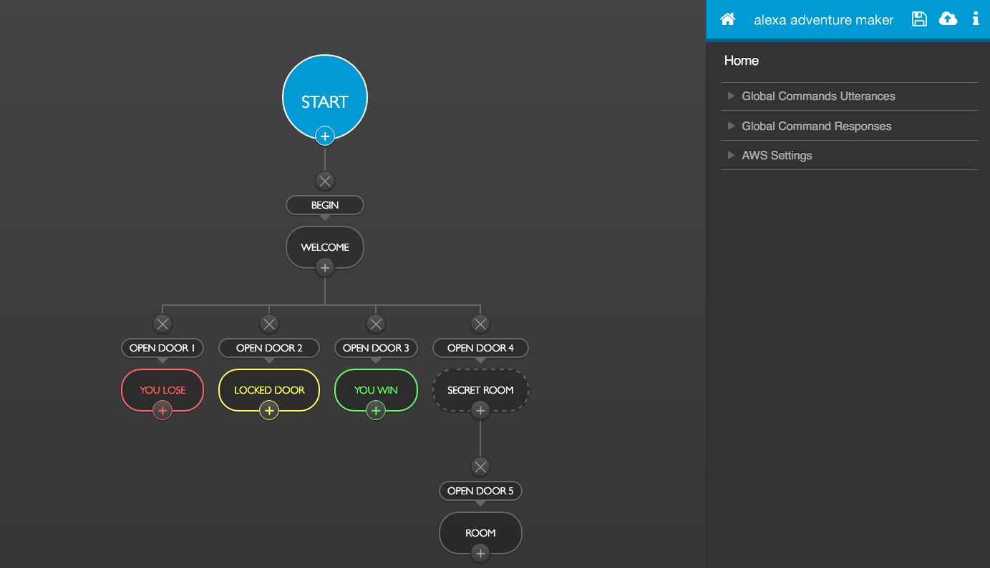
Interactive Adventure Game Tool
https://github.com/alexa/interactive-adventure-game-tool
Interactive version running here: http://10.171.204.164:3001/

Slide 34
Final Programming Section…
Skill to Ask and Store User Responses

Slide 35
Questions before moving on?

Slide 36
Additional Resources
Developing Alexa Skills – 6 part YouTube series by Amazon
https://www.youtube.com/watch?v=QxgdPI1B7rg
Learn Alexa – Codecademy – Published October 26th 2017
http://codecademy.com/learn/learn-alexa
Alexa GitHub
https://github.com/alexa

Slide 37
Questions

Slide 38
References
Walter Ong. Orality and Literacy. Routledge.

